Slide 1
DRAW: Deep Recurrent Attention Writer
A Recurrent Neural Network for Image Generation
Google DeepMind 2015
Karol Gregor, Ivo Danihelka, Alex Graves, Danilo Jimenez Rezende, Daan Wierstra
https://arxiv.org/pdf/1502.04623.pdf

Slide 2
Introduction
The DRAW Architecture mimics the foveation of the human eye with a sequential framework that allows the iterative construction of complex images.
The main contribution of the DRAW is that it extends Variational AutoEncoders with
Progressive refinement: It represents a natural form of image construction where parts of a scene are created independently from one another and approximate sketches are successively refined (temporal domain).
Spatial attention: The DRAW network is different from other image construction networks in the sense that instead of generating the image in a single pass, it iteratively constructs scenes through an accumulation of modifications emitted by the decoder, each of which is observed by the encoder (spatial domain)
The core of the network uses a pair of networks -
Encoder Network - Compresses the real images presented during training.
Decoder Network - Reconstitutes image after receiving codes.

Slide 3
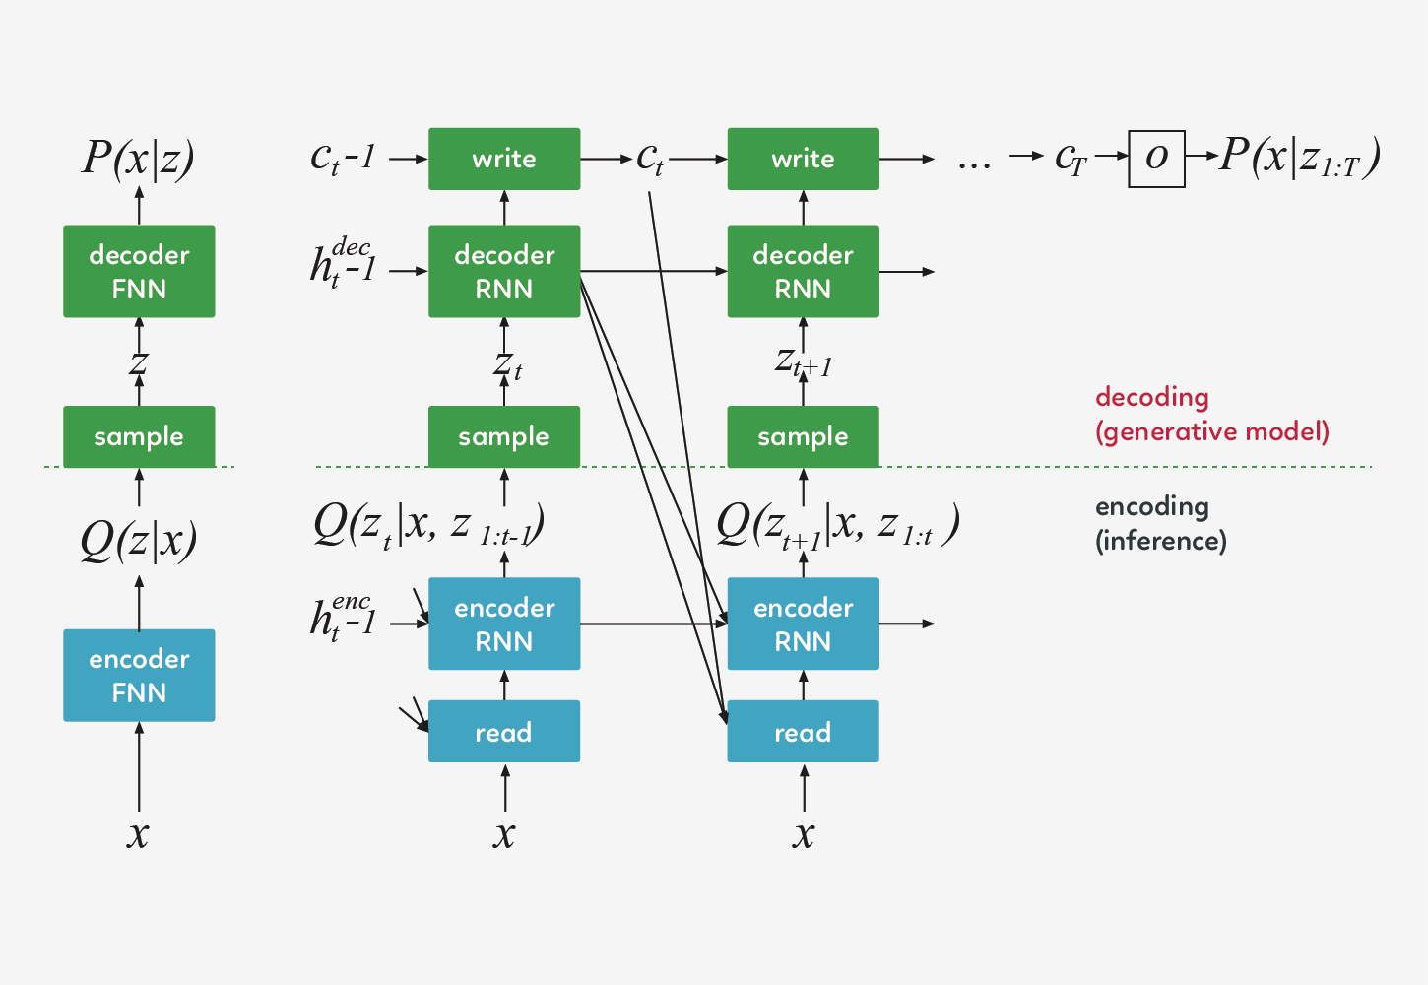
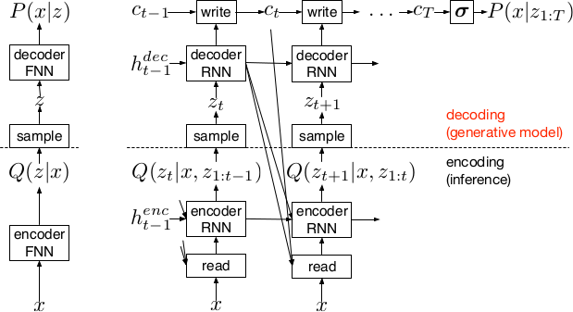
Network Architecture
The basic architecture of DRAW is Variational Auto-encoders, consisting of an encoder and a decoder.

Slide 4
Network Architecture
The basic architecture of DRAW is Variational Auto-encoders, consisting of an encoder and a decoder.
DRAW has recurrent networks(Long Short-Term Memory Architecture with h=256 for MNIST dataset) in encoder and decoder for handling long-range dependencies in real sequential data..
A dynamically updated Attention Mechanism is used for reading as well as writing. The attention model in DRAW is fully differentiable, making it possible to train with standard backpropagation(We have used Mini-batch Gradient Descent(size=100) for back propagation here).
At each time-step t, the encoder receives input from both the image x and from the previous decoder hidden vector h_{dec}. The output h_{t}^{enc} of the encoder is used to parametrize a latent distribution (diagonal Gaussian distribution Q(Z_{t}|h_{t}^{enc})) over the latent vector z_{t}.
At each time-step, a sample z_{t} ~ Q(Z_{t}|h_{t}^{enc}) drawn from the latent distribution is passed as input to the decoder. The output h_{t}^{dec} of the decoder is added to a cumulative canvas matrix c_{t}, which is ultimately used to reconstruct the image.

Slide 5
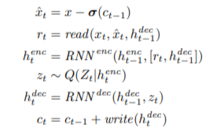
Network Architecture
For each image x presented to the network, c₀, h^{enc}₀ , h^{dec}₀ are initialised to learned biases, and the DRAW network iteratively computes the following equations for t = 1 . . . , T
where xˆt is the error image, [v, w] is the concatenation of vectors v and w into a single vector, and σ denotes the logistic sigmoid function: σ(x) = 1/ (1+exp(−x))

Slide 6
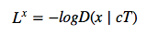
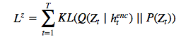
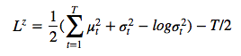
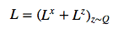
Loss Function
We shall discuss two loss functions:
Reconstruction loss L^{x},
Where, c_{T} is the canvas matrix at time T,
D refers to the distribution model considered for input data (eg- If the input is binary, the natural choice for D is a Bernoulli distribution)
Latent Loss L^{z}: the summed Kullback-Leibler divergence of some latent prior P(Z_{t}) from Q(Zt|h^{enc} t ),
a simple choice for P(Zt) is a standard Gaussian with mean zero and standard deviation one, in
which case the equation becomes
assuming latent distribution is a diagonal Gaussian with μ_{t}, σ_{t} where
The total loss function is the summation of these two loss functions
The model implements Adam Optimisation method to minimize this loss.

Slide 7
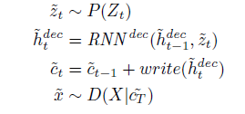
Stochastic Data Generation
An image x̅ can be generated by a DRAW network by iteratively picking latent samples ⁻⁻z_{t} from the prior P, then running the decoder to update the canvas matrix ⁻⁻c_{t}. After T repetitions of this process the generated image is a sample D(X|⁻⁻c_{T}) :
Note that encoder is not a part of image generation.

Slide 8
Attention
Attention basically refers to deciding -
Where to read/write, i.e. the x and y position in the image.
The size of the window which will be read in one iteration.
How blurry do we want our written output to be.
The NxN grid of Gaussian filters is positioned on the image by specifying the co-ordinates of the grid centre and the stride distance between adjacent filters.
The stride δ controls the ‘zoom’ of the attention patch, i.e. the larger the stride, the larger an area of the original image will be visible in the attention patch, but the lower the effective resolution of the path will be.
Two more parameters which are required to fully specify the attention model are: the isotropic variance 𝞂2 of the Gaussian filters, and a scalar intensity 𝛄 that multiplies the filter response.
The main challenge faced by sequential attention models is learning where to look, which can be addressed with reinforcement learning techniques. The attention model in DRAW, however, is fully differentiable, making it possible to train with standard backpropagation.

Slide 9
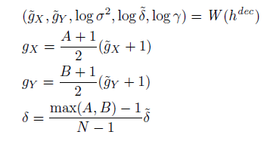
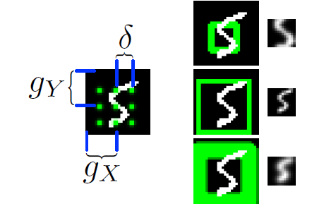
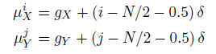
The grid centre (gx,gy) and the stride δ are given by-
Using these, we can calculate the mean location μ^{i}_{x} μ^{i}_{y} of the filter at row_{i} ,column_{j} as-

Slide 10
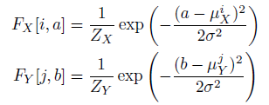
Given the attention parameters emitted by the decoder, the horizontal and vertical filterbank matrices F_{X} and F_{Y} (dimensions NxA and NxB respectively) are defined as follows:
where (i,j) is a point in the attention patch, (a,b) is a point in the input image, and Z_{X} , Z_{Y} are normalisation constants that ensure that-

Slide 11
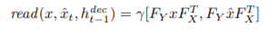
Read Attention
The read operation returns the concatenation of two N × N patches from the image and error image
The “read” attention consists of two parts:
Choosing the important portion
Cropping the image and forget about other parts

Slide 12
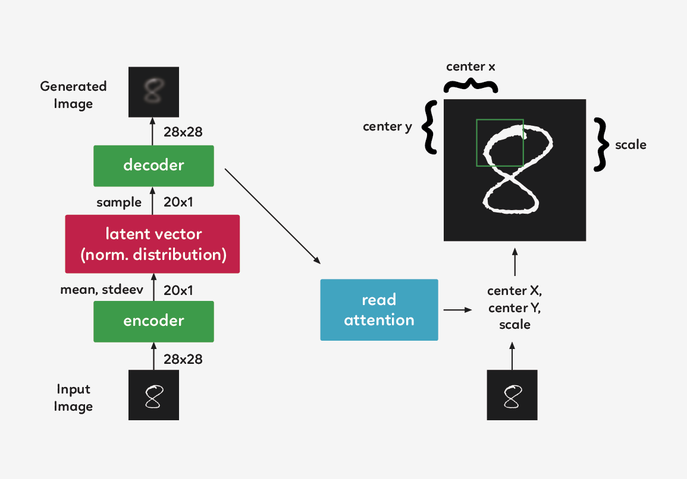
Choosing important part of the image
We shall use the previous timestep’s decoder hidden state to decide what to focus on. Using a simple fully-connected layer, we can map the hidden state to three parameters that represent our square crop: center x, center y, and the scale(or stride).

Slide 13
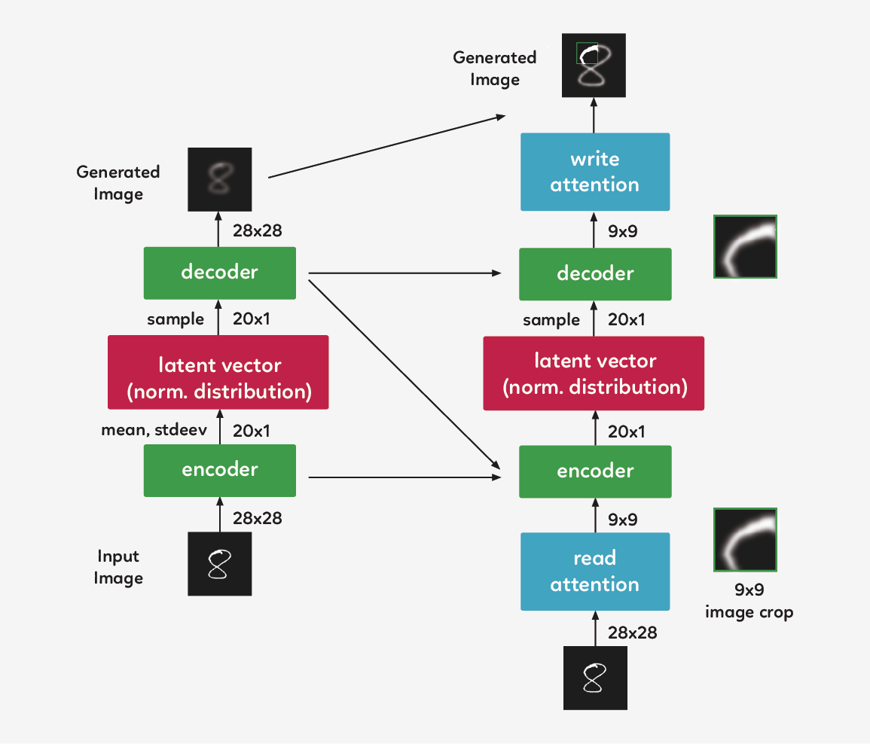
Cropping the image
Instead of encoding the entire image, we crop it so only a small part of the image is encoded. This code is then passed through the system, and decoded back into a small patch. This is implemented using Gaussian filters.

Slide 14
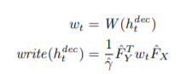
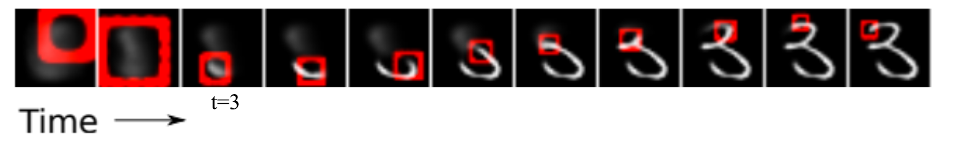
Write Attention
For the write operation, a distinct set of attention parameters γˆ, Fˆ_{X} and Fˆ _{Y} are extracted from h ^{dec} _{t} ,
where w_{t} is the N × N writing patch emitted by h ^{dec}

Slide 15
Steps followed to re-implement the paper
Read the MNIST data.
Set up the configuration for the LSTM cell.
Construct a placeholder for the image.
Construct the encoder and decoder operation.
Construct the initial state (zero state) for the encoder and decoder.
Unroll LSTM into T steps.
Construct the encoder and decoder node at each time step.

Slide 16
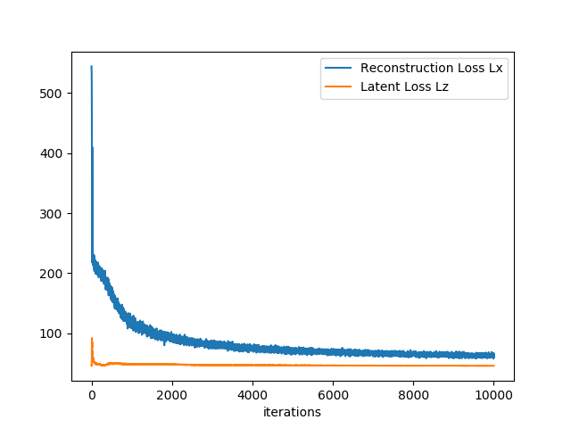
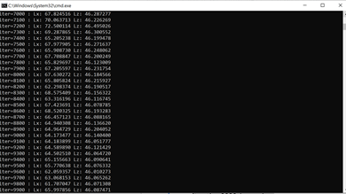
Result
DRAW can generate realistic looking images. The network was trained by us on MNIST database. However, the research paper also performed training on the following other datasets:
SVHN (Street View House Numbers)
CIFAR-10
The image generated by network are always novel(not simply copies of training examples) and are indistinguishable from real data.
Iteration 0: Lx=542.97, Lz=46.30
Iteration 9900: Lx=65.99, Lz=46.08

Slide 17
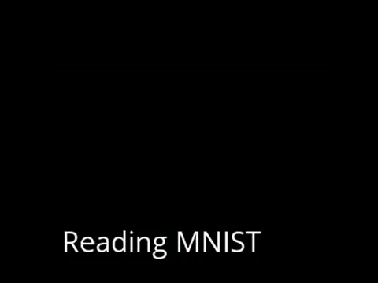
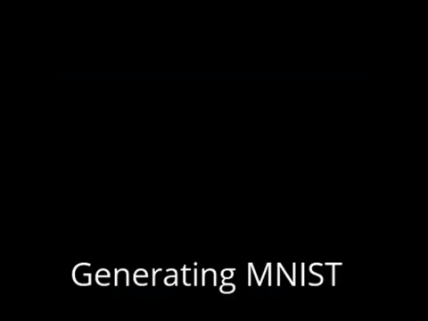

Slide 18
THANK YOU!
Parth Misra (2016B5A70560P)
Aaryan Kapoor (2016B4A70166P)
Satyansh Rai (2016B4A70632P)

